Slide 1
PlanTris
- A plant care web app using ml
29. 04. 2023
Done By-
Nirmal S, 4th Yr CSE, RMK Engineering College
Mahalakshmi S, 4th Yr CSE, RMK Engineering College
-”Empowering plant care, at one click with PlanTris”

Slide 2
Contents
01
02
03
04
Abstract
Problem Definition
Proposed Solution
Idea
05
06
07
08
Existing System Vs Proposed System
Expected Outcome
Technologies Used
Process Flow Chart
09
Output

Slide 3
01 - ABSTRACT
PlanTris is a web app designed to provide a one-stop-shop for all aspects of plant care and farming.
The app features an e-commerce platform for purchasing plants and other supplies online, making it easier for users to access the materials they need to care for their crops.
The forum feature allows users to ask questions and get advice from other members of the PlanTris community, making it a valuable resource for people who are just starting out in farming or need guidance on caring for their plants.
The one-on-one consultation service connects users with registered farmers who can provide personalized advice on their specific crops and growing conditions, helping users address plant diseases, pest infestations, and other problems.
PlanTris also includes image recognition technology for diagnosing plant diseases, allowing users to take a picture of their plants and receive a diagnosis and remedy suggestions for any diseases or pests that are present.
The reminder system helps users stay on top of plant care tasks like watering and fertilizing, ensuring that their plants receive the care they need to thrive.
With its user-friendly and intuitive design, comprehensive plant care information and resources, and potential for improving agricultural outcomes and reducing the burden on farmers, PlanTris is a valuable tool for farmers and people interested in farming and plant care.

Slide 4
02 – PROBLEM STATEMENT
Many people struggle to keep their plants healthy and thriving due to a lack of knowledge or a busy schedule. This results in plants dying or not growing to their full potential, causing frustration and disappointment for plant owners. Additionally, new plant owners may feel overwhelmed by the sheer number of plant varieties available and the various care requirements for each plant.
03 – PROPOSED SOLUTION
Lack of expertise and resources can make plant care difficult for home gardeners and small-scale farmers. Plantris seeks to provide a one-stop-shop solution for all aspects of plant care and farming, including an e-commerce platform, forum, consultation service, image recognition technology, and reminder system.

Slide 5
04 - IDEA
Creating a comprehensive platform for plant care and farming that combines multiple features and resources in one place.
Building a community of plant enthusiasts and farmers who can interact, share knowledge, and learn from each other through the web app.
Promoting sustainable agriculture practices and environmentally-friendly approaches to plant care and farming.
Increasing accessibility to plant care and farming resources for users who may not have access to traditional farming resources or expertise.
Providing a user-friendly and intuitive interface that is accessible to all users, regardless of their level of expertise or experience in plant care or farming.
Promoting local agriculture and community involvement by connecting users with local farmers and suppliers, and encouraging the use of locally grown and produced products.
Offering resources and guides for different types of plants and crops, including best practices for planting, watering, fertilizing, and harvesting.

Slide 6
05 – EXISTING VS PROPOSED SYSTEM
E-commerce platforms like Amazon and Home Depot offer plant and supply purchasing online, but lack the expertise and tailored support of a platform like PlanTris.
Forums like GardenWeb and the Farming Forum provide a community for sharing advice, but may not offer expert advice or personalized support.
Mobile plant disease diagnosis apps like Plantix and Agrobase use image recognition to diagnose plant diseases, but may not be as reliable or informative as consulting with a plant expert.
Plant care reminder apps like Garden Compass and Waterbot allow for setting reminders, but may not be as comprehensive or customizable as PlanTris.
PlanTris fills gaps in plant care expertise, support, and integration by offering a single platform with multiple features and resources, making it more accessible and manageable for users.
06 - EXPECTED OUTCOME
A strong community of plant enthusiasts and farmers who can share knowledge, ask questions, and support each other in their plant care and farming journeys.
Increased accessibility to plant care and farming resources, making it easier for users to grow healthy plants and crops.

Slide 7
07 – TECHNOLOGIES USED
Front-end technologies like HTML, CSS, and JavaScript for designing and building the user interface of the web app.
Back-end technologies like PHP or SQL for handling the server-side of the web app, managing databases, and processing user requests.
Frameworks like React or Angular for creating dynamic and responsive user interfaces.
Image recognition libraries like TensorFlow or OpenCV for analyzing plant images and identifying diseases.
Machine learning algorithms to improve the accuracy and speed of disease diagnosis and plant care recommendations.
Application programming interfaces (APIs) for integrating with other services or tools, such as e-commerce platforms, payment gateways, or weather data providers.
Collaboration and project management tools like GitHub or Trello for facilitating team communication and task tracking.

Slide 8
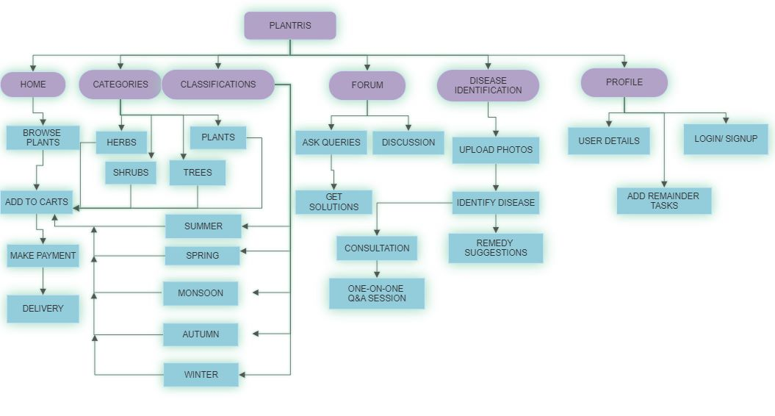
08 – PROCESS FLOW CHART

Slide 9
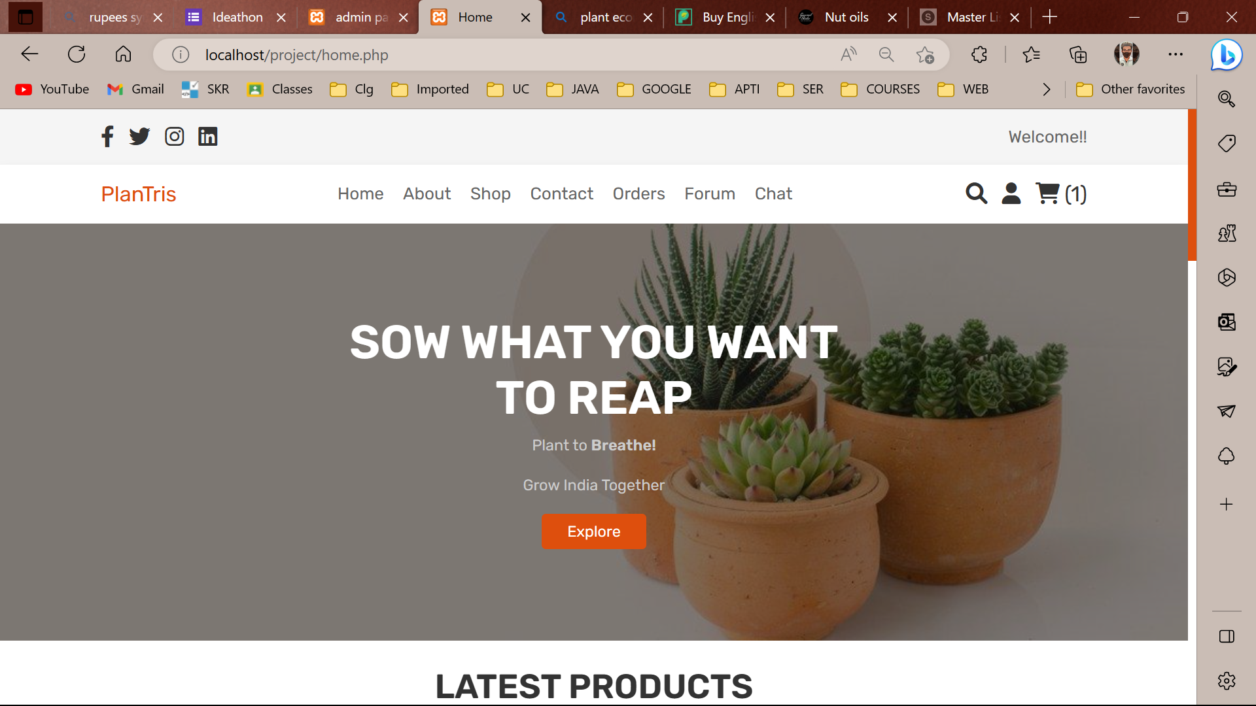
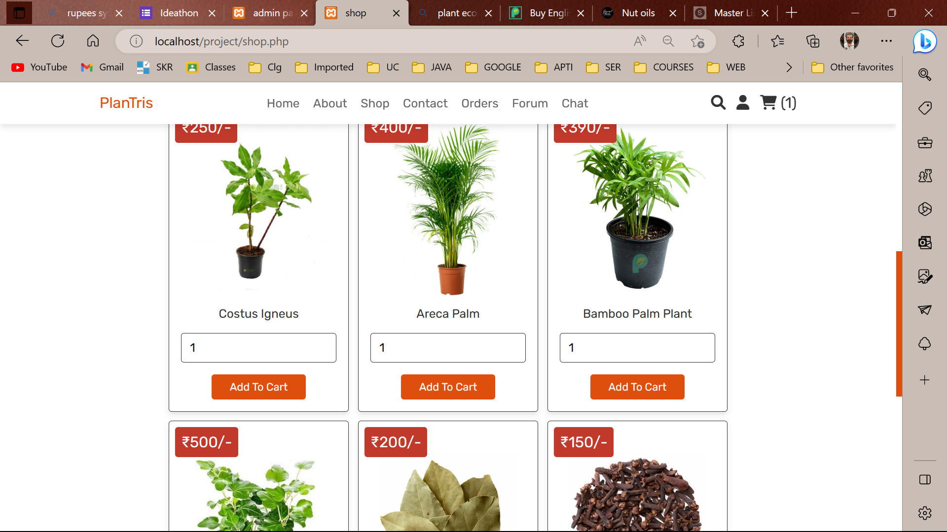
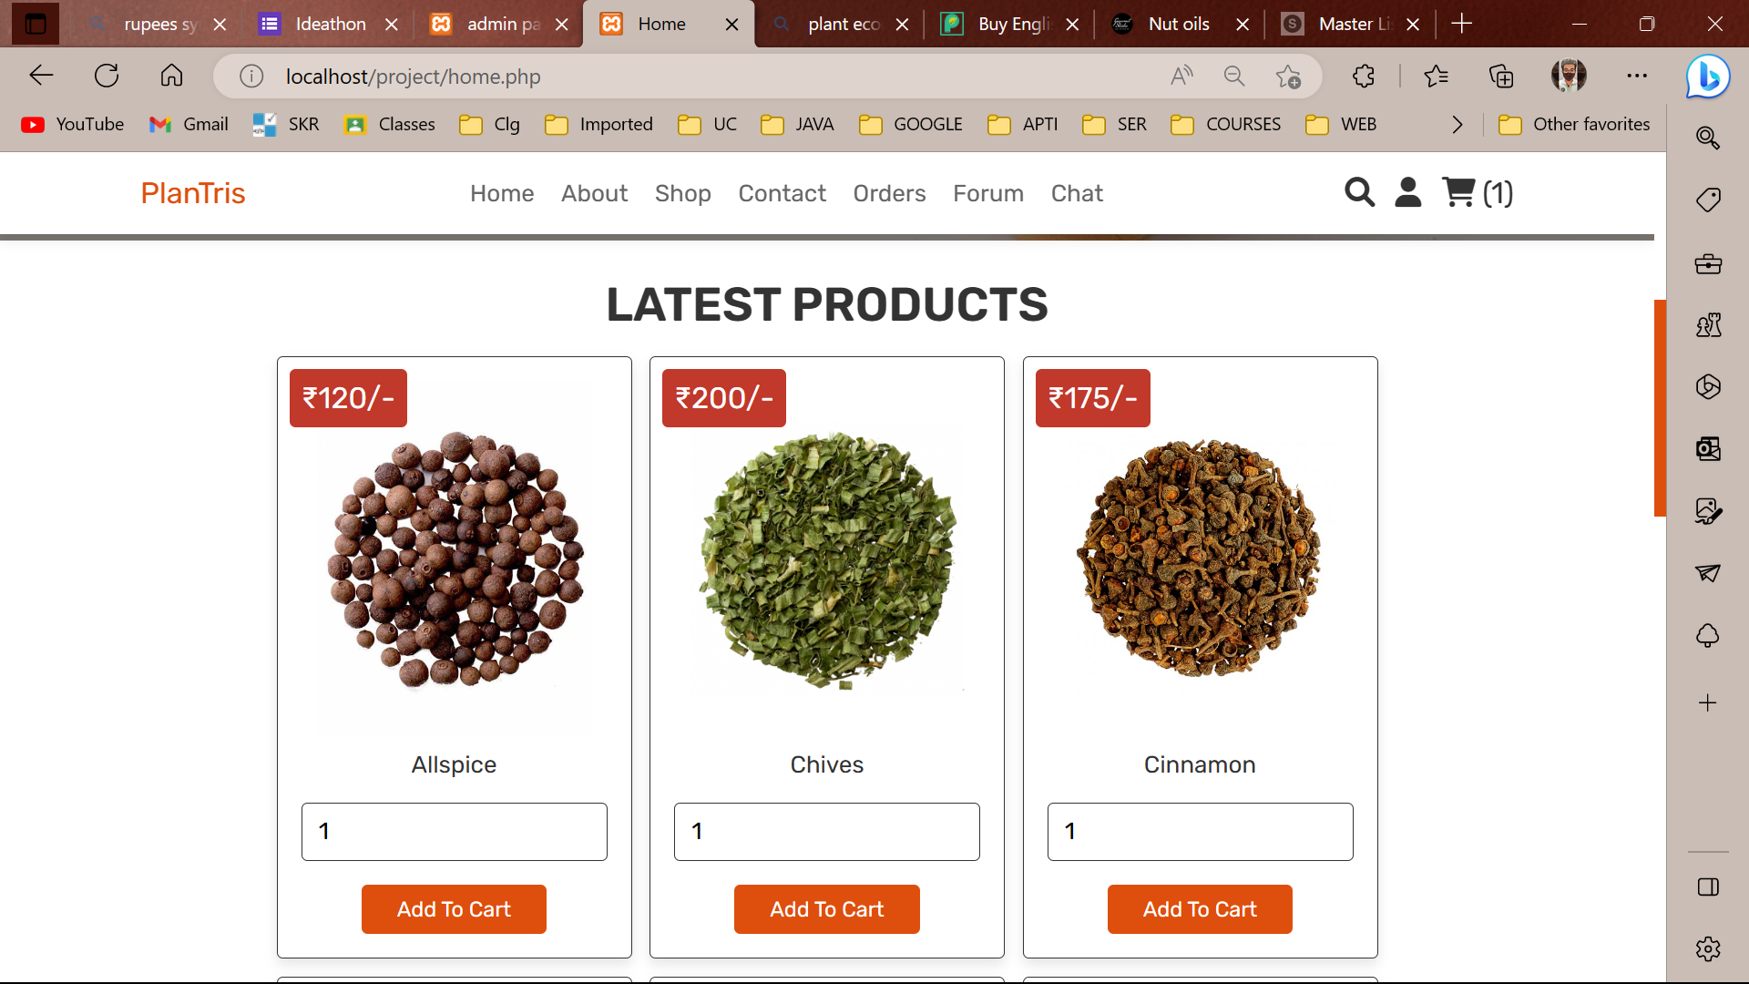
09 – OUTPUT

Slide 10
10 – Steps to run our project !
Extract the zip file.
Install XAMPP server with Apache and MySQL.
Copy extracted files to "htdocs" folder in XAMPP directory.
Update path settings in the project folder.
Start Apache and MySQL in XAMPP control panel.
Open "https://localhost/project" in the browser to run the project.

Slide 11
Thanks !
https://drive.google.com/file/d/16c4eWKLKW5as6x9zUf-6sqB965hFJQaC/view?usp=sharing

